Slide 1

The fine balance Exploring the Interplay of Reproductive Strategies and Growth Dynamics in Trees
Faculty of Forestry, University of British Columbia
1st Doctoral Committee Meeting
Xiaomao (Mao) Wang
Supervisor: Elizabeth Wolkovich
Notes:
Good afternoon, thank you for taking time to come to my committee meeting. I am excited to present an overview of my PhD project and my plan for my PhD student.

Slide 2

Table of content
Personal background
Research chapters
Current progress
Milestones timeline

Slide 3


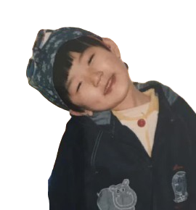

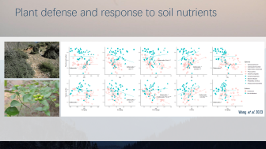

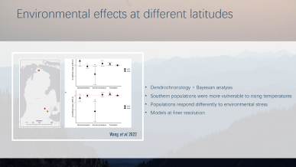
My personal background
Beijing Normal University-Hong Kong Baptist University United International College
Zhuhai, China
University of Michigan
Ann Arbor, US
Xishuangbanna Tropical Botanical Garden
Xishuangbanna, China
Harbin, China
Notes:
I was born and raised in Harbin, a city in northeastern China, where I often gazed at the rolling mountains outside my window, wondering: What’s on the other side?

Slide 4
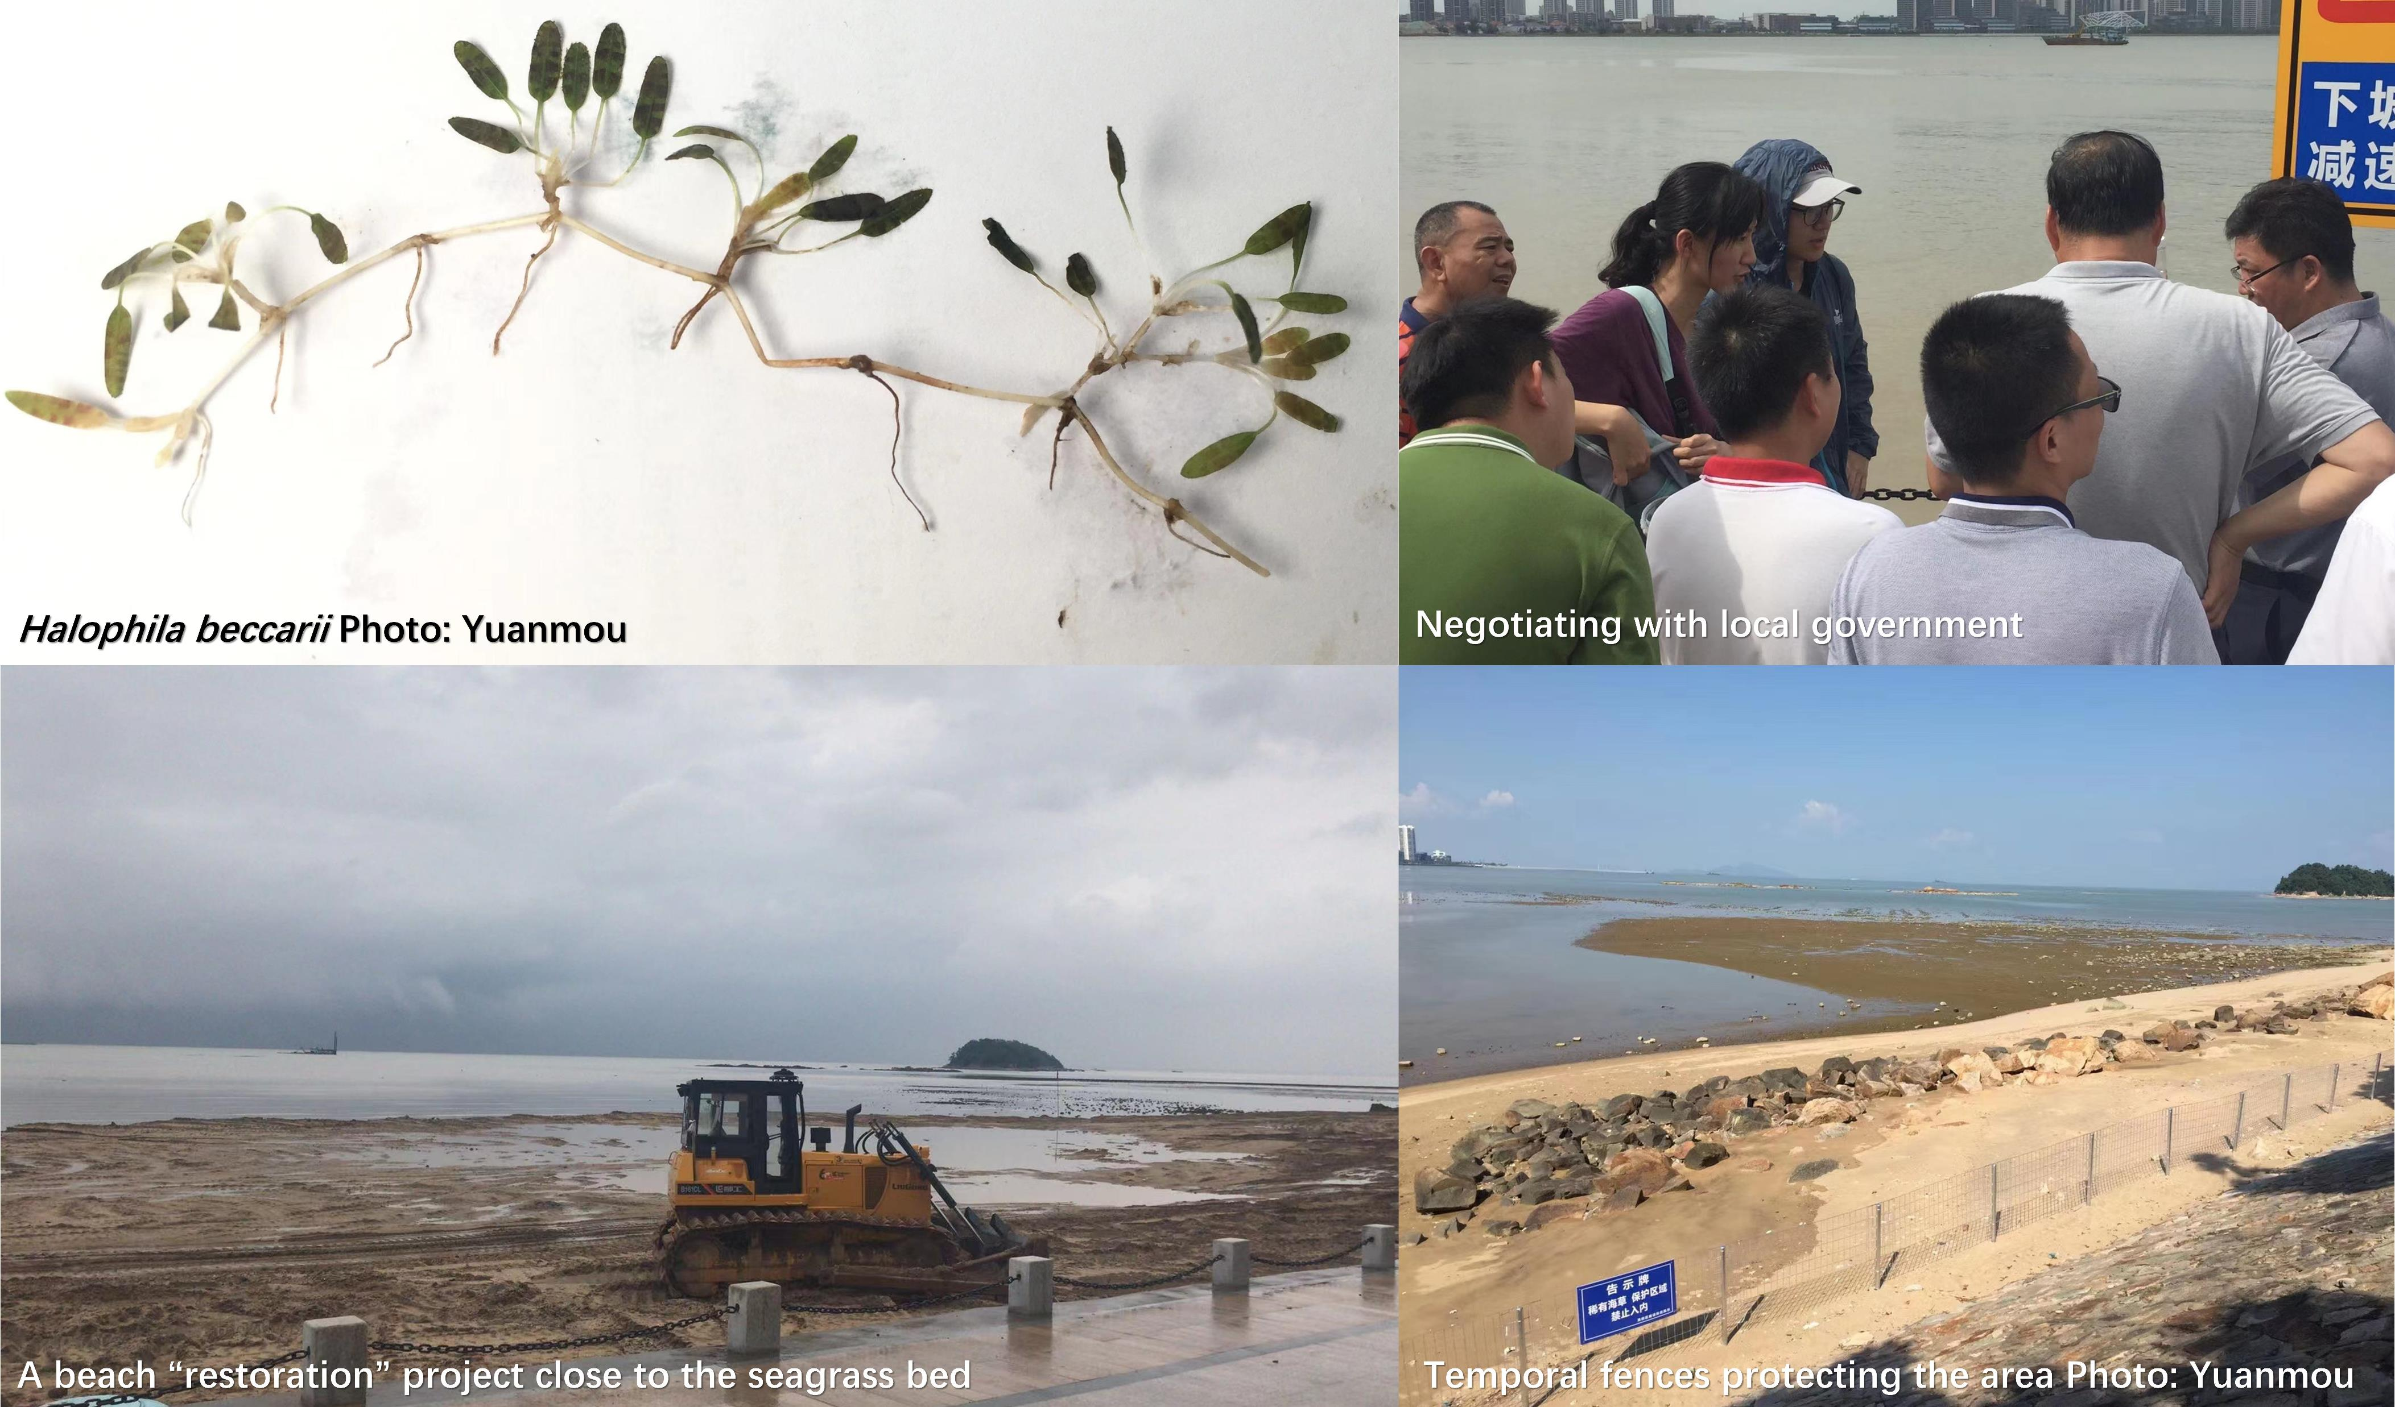
Seagrass conservation
Notes:
This curiosity led me to move to the southeastern part of China for college, where I first encountered ecology. For my final-year project, I studied the community ecology of a threatened seagrass species. Toward the end of our work, a restoration project was proposed to cover the seashore with fine sand. My team worked hard to negotiate with various stakeholders, ultimately stopping the project. And now the seagrass bed is protected. This was the first time I realized that studying ecology isn’t just about learning—it’s about making tangible change, even if it’s just a small one.

Slide 5
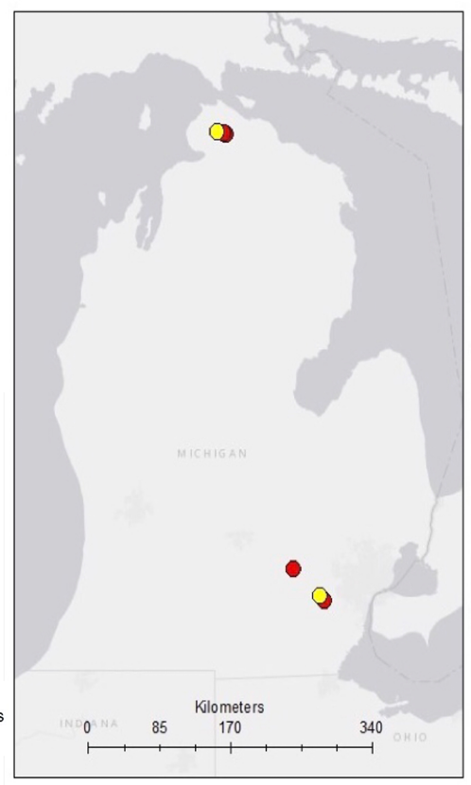
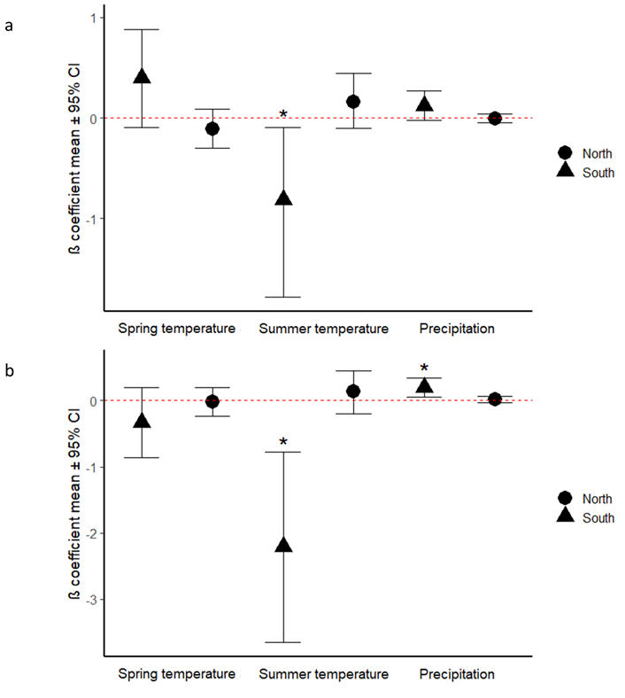
Wang et al. 2022
Environmental effects at different latitudes
Dendrochronology + Bayesian analysis
Southern populations were more vulnerable to rising temperatures
Populations respond differently to environmental stress
Models at finer resolution
Notes:
My growing interest in ecology brought me to the University of Michigan for graduate school, where I worked with Prof. Ines Ibanez. I studied how environmental factors affect two maple species (Acer rubrum and Acer saccharum) at different latitudes. Our results showed that the southern populations were more vulnerable to rising temperatures, and climate projections suggested they could face significant declines in the future. This research helped document how populations respond differently to environmental stress, which help make predictions at a finer resolution. This work was published in Forests.

Slide 6
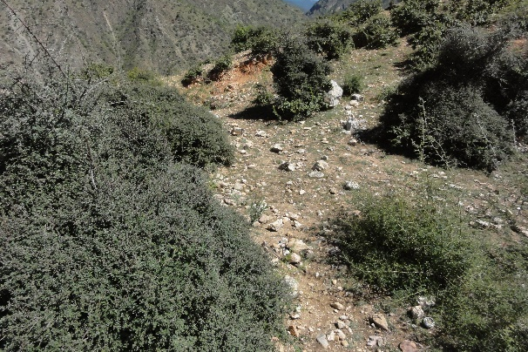
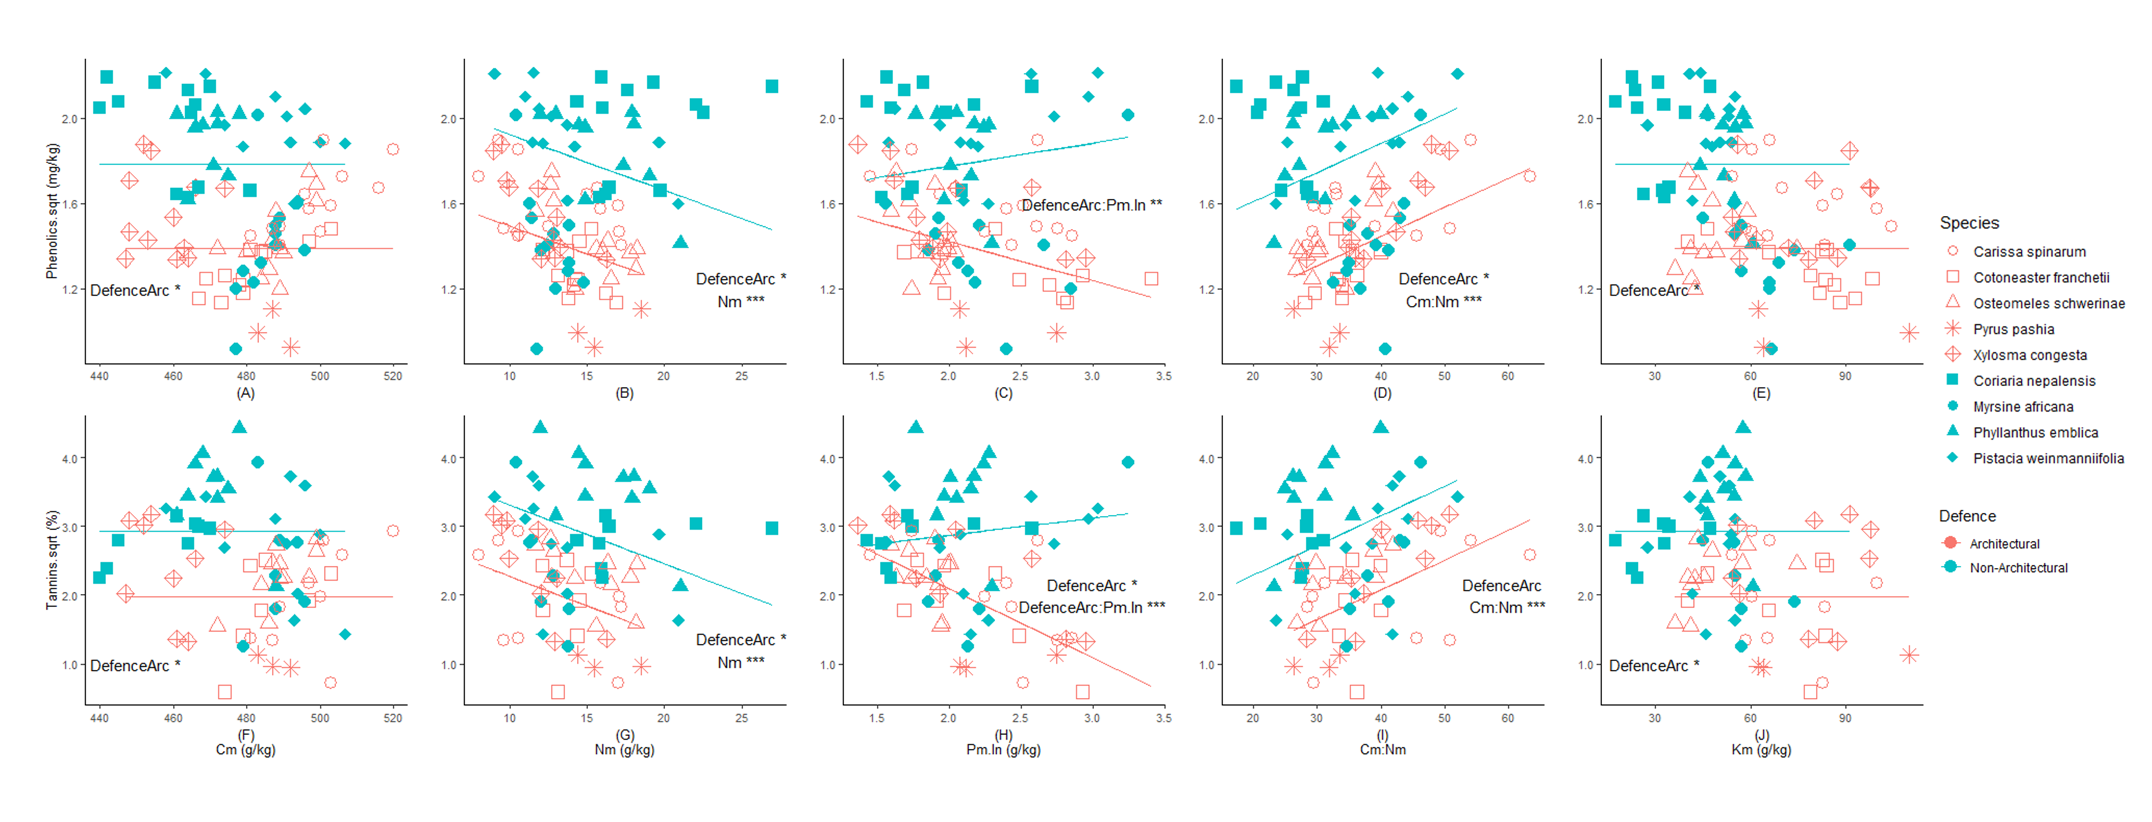
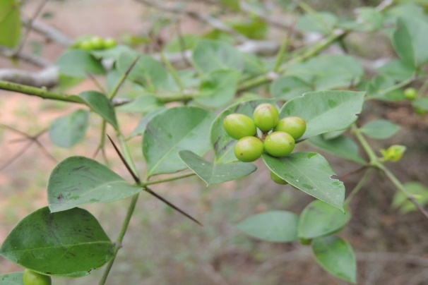
Plant defense and response to soil nutrients
Wang et al. 2023
Notes:
After graduation, I took a break from school and worked as a research assistant in Prof. Kyle Tomlinson’s lab, studying the ecology of savanna ecosystems. I became interested in how soil nutrients influence plant defense strategies. We developed a model showing that architectural plants, which have high nutrient content and low phenolic compounds, rely on structural defenses to deter herbivores. However, as soil nutrients increase, non-architectural plants with low nutritional value become more palatable to herbivores. This study highlighted how changes in soil phosphorus, especially in nutrient-limited environments like the tropics, can shape plant defense strategies. This study was published in Physiologia Plantarum

Slide 7
Mast seeding
Synchronized variation of large seed crop within a population between years
Characteristics:
Interannual variation
Synchrony
Temporal autocorrelation
frequency
Notes:
After three years in academia, I felt it was time for the next step, and here I am today. When I first spoke with Lizzie about my potential PhD project, she asked me, “Do you know what masting is?” At the time, I had no idea what this term meant, but after she explained it, I remembered my favorite childhood snack—pine nuts. We could only find those giant Korean pine cones at the farmers' market every few years. People would go to local forests to forage for them. Masting is the phenomenon where plants exhibit synchronized variation in seed production across years within a population. It is closely tied to ecosystem-level functions, as seeds serve as food for many mammals or hosts for some pathogens. While masting is most common in wind-pollinated species, it also occurs in Poaceae and Dipterocarpaceae. Some literature even suggests that certain fruit trees also mast. Mast seeding is characterized by four main features: Interannual variation: Seed production varies in magnitude across years. Synchrony: Seed production is synchronized across individuals and populations, sometimes extending over hundreds of kilometers. Temporal autocorrelation: High seed production years are typically followed by low seed production years. Frequency: Masting occurs every few years, and this frequency generally remains stable over time.

Slide 8
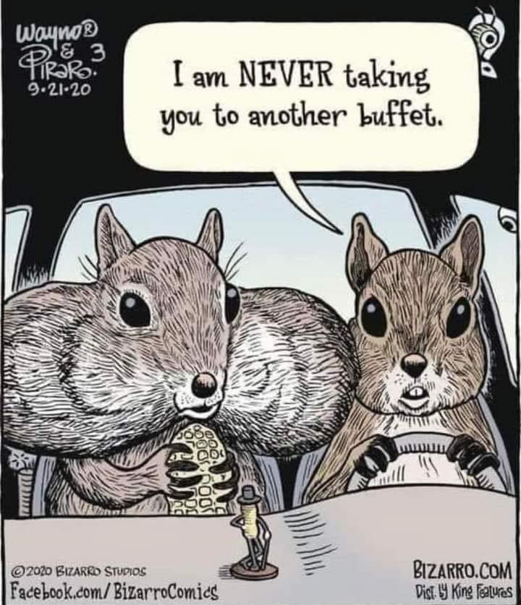
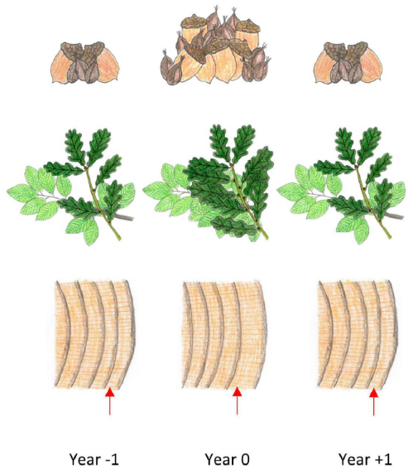
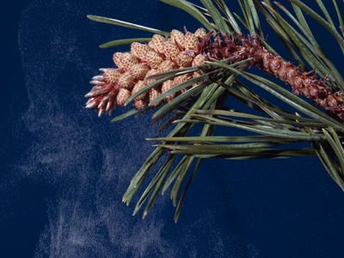
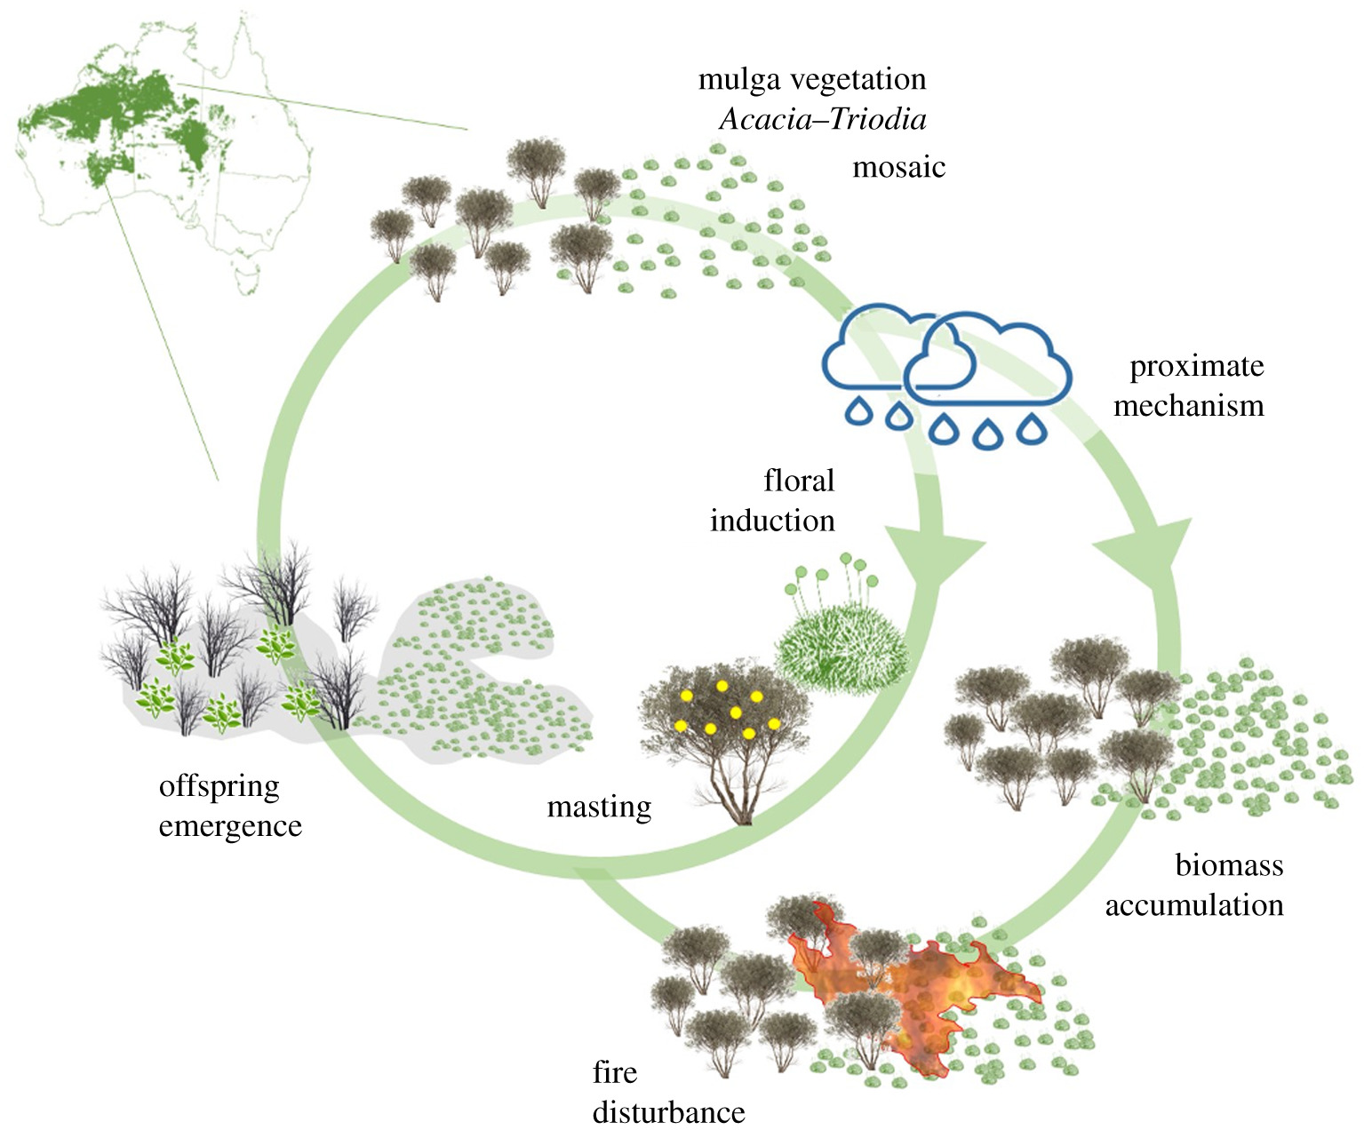
Hypotheses on masting
Predator satiation
Resource matching
Pollination coupling
Environmental cues
Nussbaumer et al. 2021; Vacchiano et al. 2021
Notes:
The exact reasons why plant mast is still not fully understood, but there are some hypothesis.
First is predator satiation hypothesis. Picture the masting year as a big buffet. When there are so much food, even the hungriest predators can’t possibly finish it all. Some seeds get eaten, but most of them survive because there are just too many to consume. And in the following years, when the seed predator bring the whole family and ready for another big buffet, there isn’t one. By masting, plants manipulate the population of seed predators and also ensure the success of their reproduction.
The next intuitive hypothesis is resource matching. A fixed fraction of resources is allocated to reproduction each year. Plants can simply be matching their reproductive output each year to the variable resources available to them.
Pollination coupling hypothesis predicts that weather and plant resources drive the flowering effort of trees, highly synchronized flowering time enable more pollination and more production of seeds.
Environmental cues believes that certain environmental shift will trigger the masting events.

Slide 9
Research questions
1. What are some reproductive traits related to mast seeding
2. What is the relationship between masting and growth
3. How changing climate is going to affect seed dynamics
Notes:
While these hypotheses somehow explain the mechanisms of masting, the main factors driving masting events can vary depending on the species and the abiotic environment. Masting plays an important role in shaping mammal dynamics, as the seeds are food source manipulate the mammal population. Masting also directly affects seed dynamics and forest regeneration. Thus, studying masting is key to understand the broader ecological processes that govern forest ecosystems. For my PhD dissertation, I will delve deeper into the complex dynamics of masting by addressing several key questions that will help understand drivers and implications: What reproductive traits are associated with mast seeding? This question will explore the specific characteristics of plants that enable or influence their ability to produce large, synchronized seed crops. What is the relationship between masting and tree growth? Here, I aim to examine how masting events may be linked to the growth patterns of trees and whether there is a trade-off between reproduction and growth. How changing climate affect seed dynamics? This question will investigate how changing environmental conditions might change masting behavior and its broader ecological consequences. These research questions will provide a comprehensive framework to understand how masting behaviors function in a changing climate and how they may influence the structure and dynamics of forest ecosystems.

Slide 10
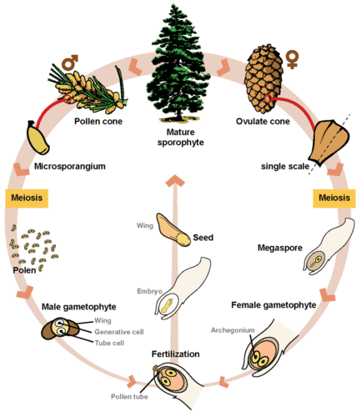
Reproductive traits versus masting
Pollination (pollination coupling)
Type of reproduction (monoecious or dioecious)
Flowering duration
Methods of pollination
Seed maturation (resource matching)
Leaf longevity
Determinacy
Seed dispersal (Predator satiation)
Seed size
Nutrient content
Dispersal mode
Seed dormancy
Seed longevity
Environmental cues
Biomes
Forestry type
Notes:
Masting is widely observed in plants, but not all tree species have this unique reproductive strategy. In the first chapter of my study, I will conduct a meta-analysis to explore which reproductive traits are most closely associated with a species tendency to mast.
I will focus on reproductive traits at different stages of the reproductive process: pollination, seed maturation and seed dispersal. Each of these stages might be most closely related to whether there is a mast seeding event or not. These stages are also linked to the hypotheses we mentioned earlier. By examining these traits through the perspective of specific hypotheses at different stages, we can gain a better understanding of the selective pressures driving this phenomenon.
Starting with the pollination stage, several reproductive traits may be related to the success of pollination efficiency. Traits might be relevant include the type of reproduction, whether the species is monoecious, or dioecious, as well as the duration of flowering and the pollination mode. These factors are closely linked to the pollination coupling hypothesis, which suggests that synchronizing flowering among individuals or populations increases pollination efficiency which ensure the seed production.
Moving to the seed maturation stage, some important traits may be relevant to masting behavior include leaf longevity and determinacy which could affect the timing of seed development and plant’s ability to invest in reproduction.
Finally, when seeds mature and are ready for dispersal, the role of seed predators becomes important. According to predator satiation hypothesis, masting overwhelms seed predators by producing large numbers of seeds, on the other hand, masting species may also rely on seed dispersers to carry seeds away from the parent tree, increasing the chances of seedling survival. In this context, seed traits such as seed size, nutrient content, dispersal mode, seed dormancy and seed longevity may all play key roles. Larger seeds and seed with higher nutrient content might be more attractive to seed predators, seed dormancy and seed longevity help ensure that seeds do not germinate immediately after dispersal, allowing them to wait for a better chance to establish in a favorable environment, since mast only happen once in several years, these traits might be important for these seed to survive.
Together with reproductive traits, I am also thinking of including biomes, forest type see if these environmental factors might result in mast. By examining these traits within the framework of relevant ecological hypotheses, we can gain a clearer picture of why some species engage in masting and others do not. This knowledge will help understand the evolutionary strategies behind masting.
We are currently scraping data from Silvics of North America, MASTREE+ and some other papers.

Slide 11
Growth-reproduction trade-off
Growth
Defense
Resources
Reproduction
Storage
Notes:
Plants have limited resources and must actively allocate them to support survival and reproduction. How they allocate their resources is influenced by environmental factors and the plant’s life history strategy. Trade-offs are important for plant fitness because plants cannot maximize all aspects of their life processes with limited resources. Masting as a special reproductive event involving the production of lots of seeds in certain yet, it is intuitive to expect a growth-reproduction trade-off, with the growth of plants during masting years might be impacted. This relationship might be even more complex for conifer species, whose reproductive cycles typically last for two years. In this chapter, I will combine growth data, seed trap data and climate data to explore the relationship between masting and plant growth.

Slide 12
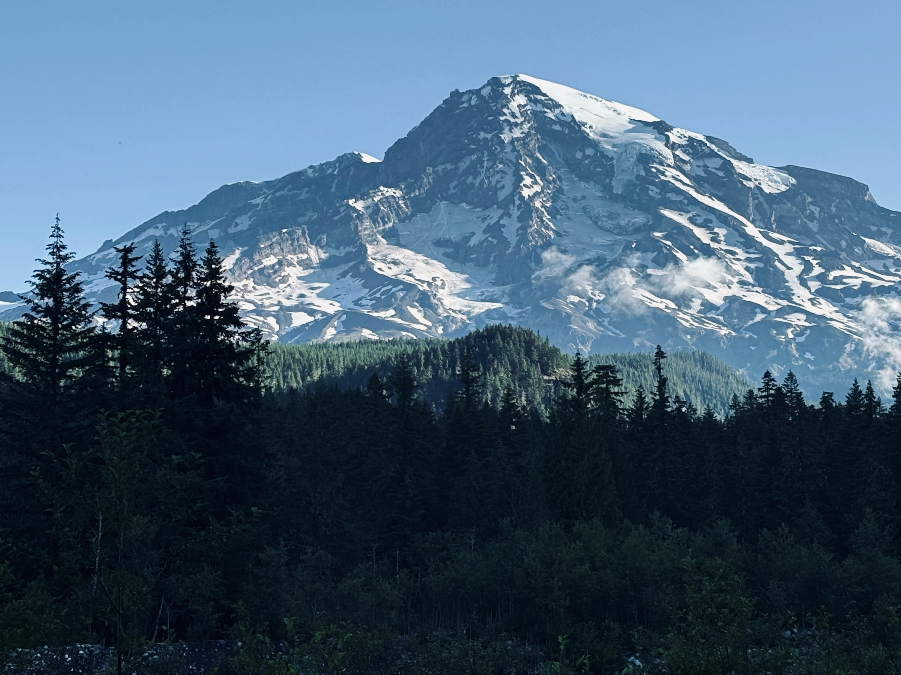
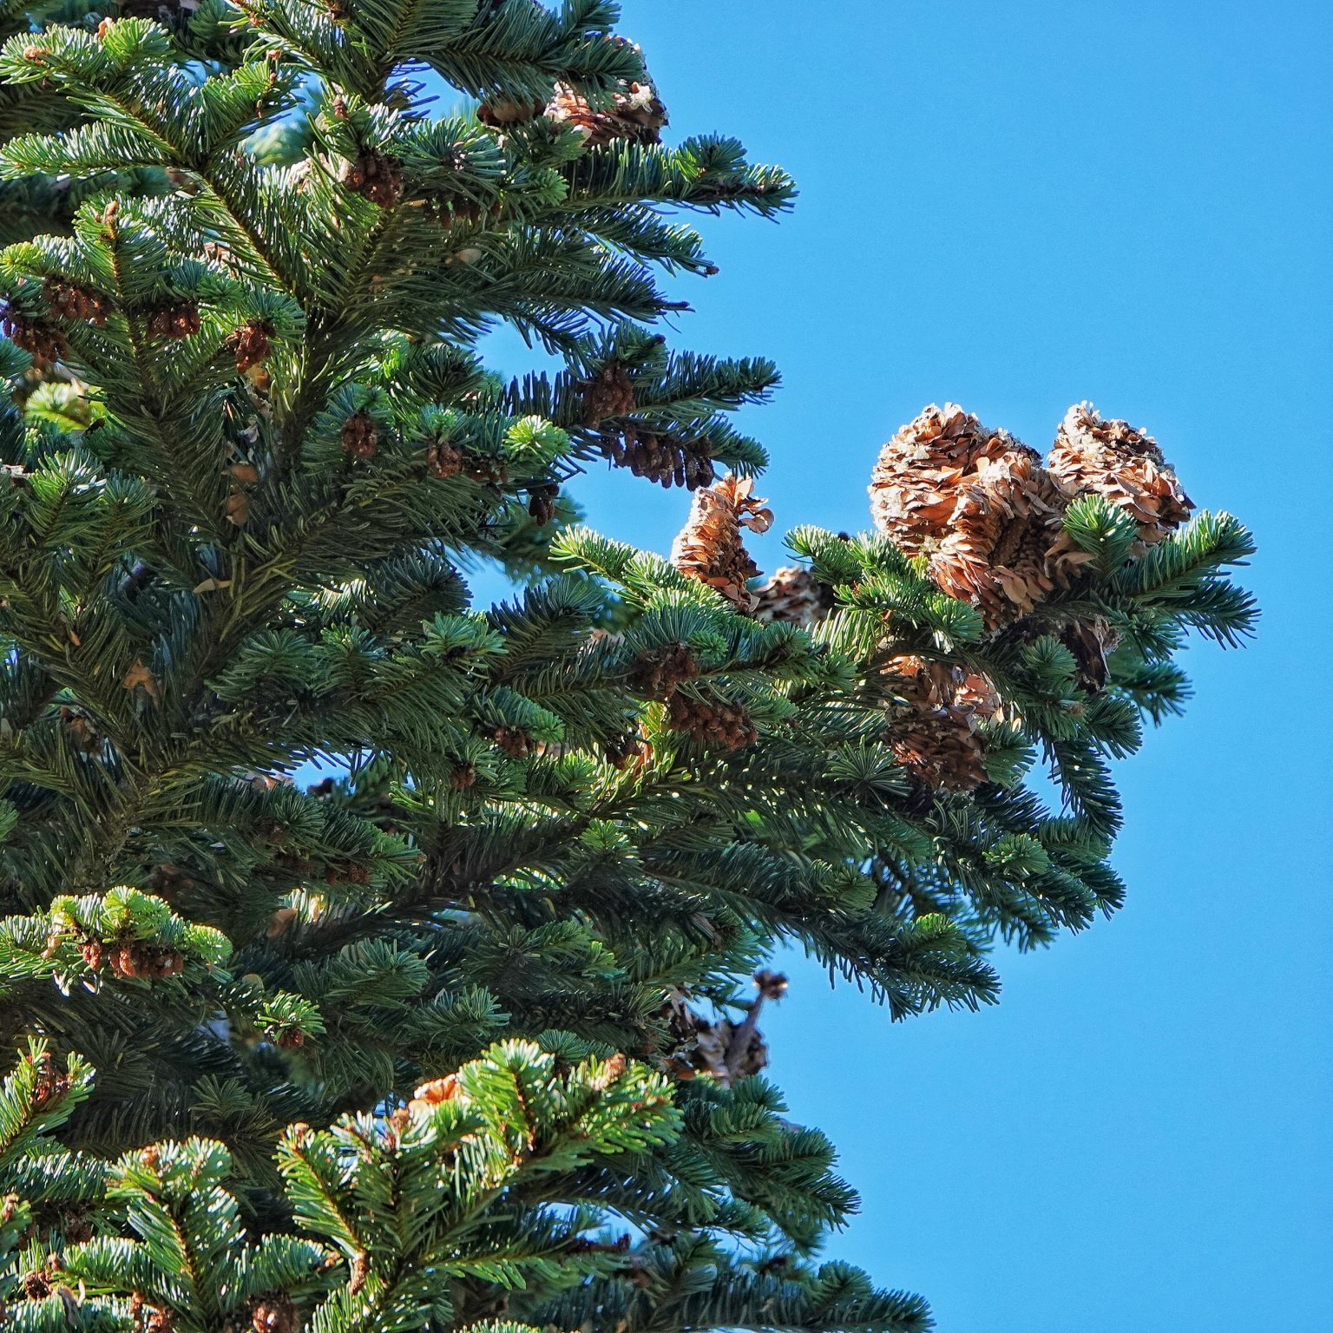
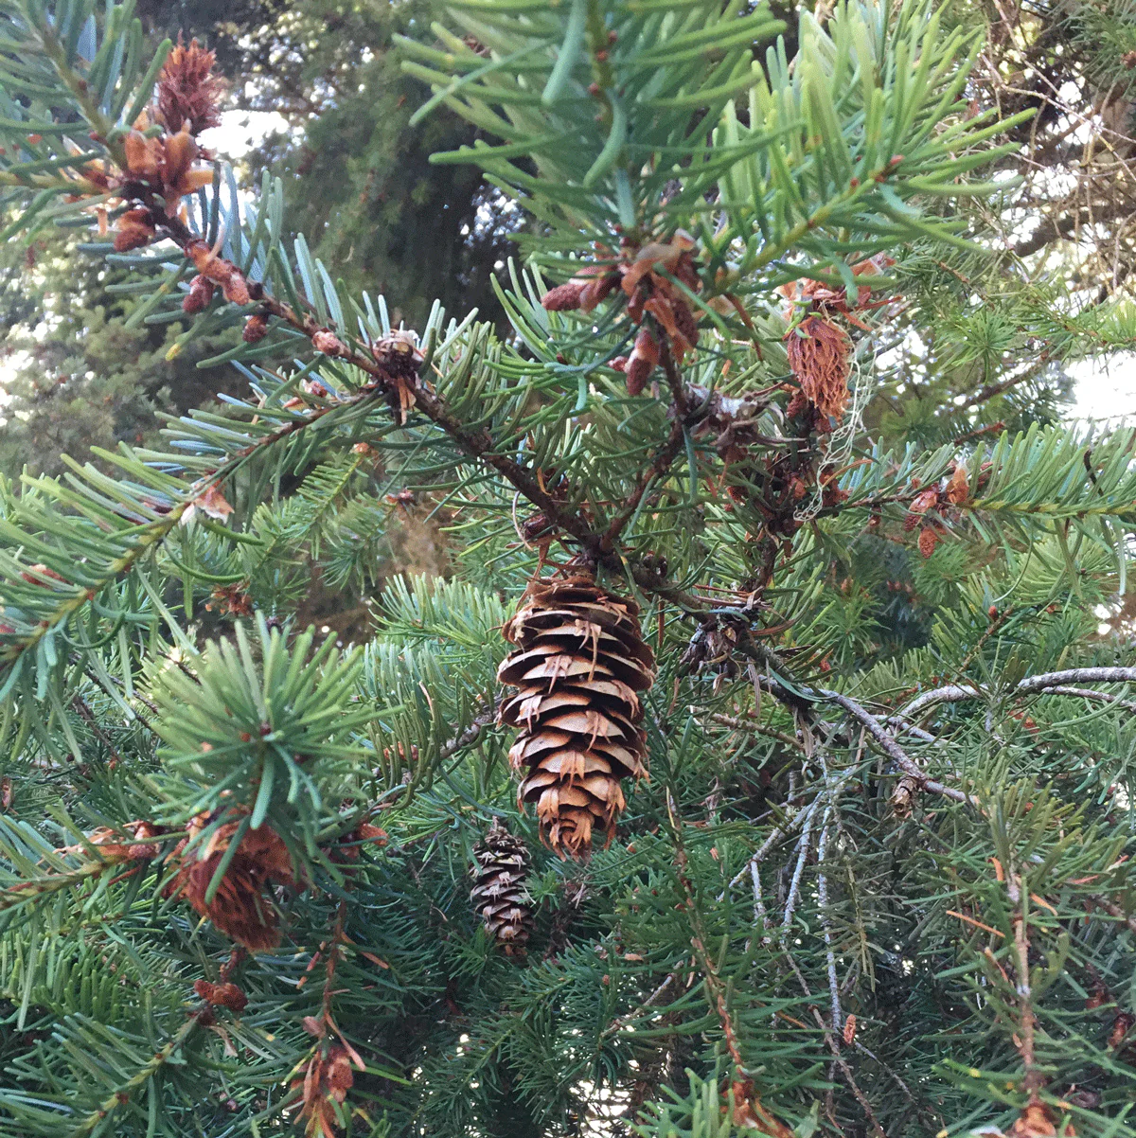
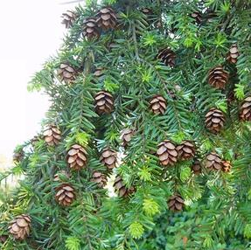
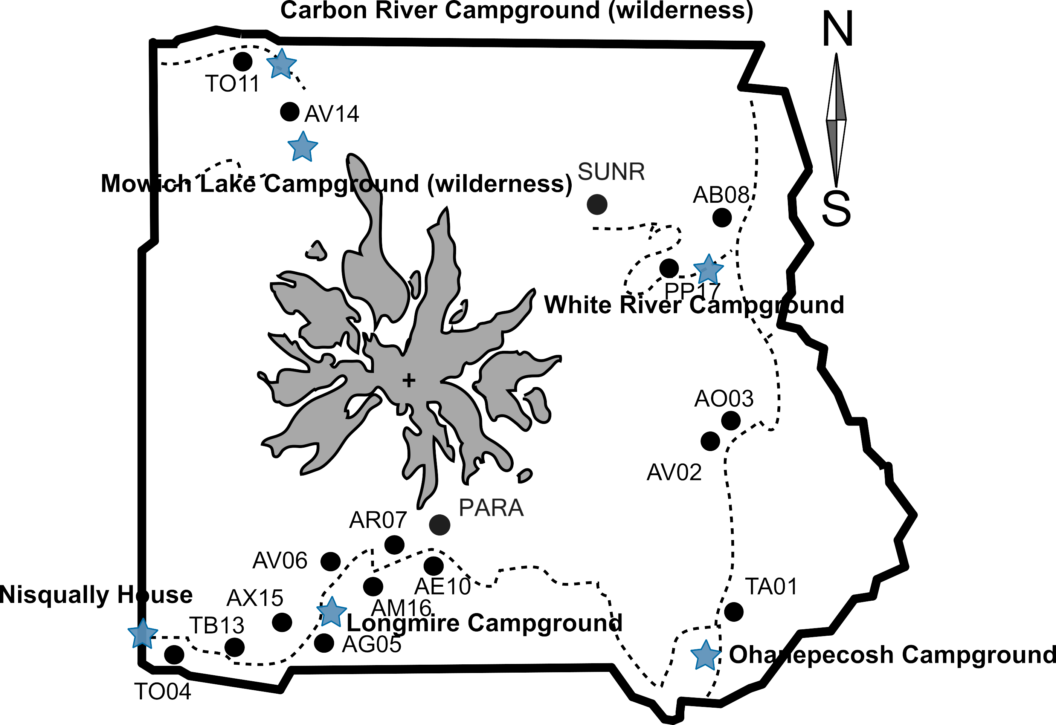
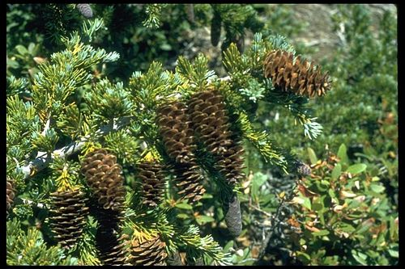
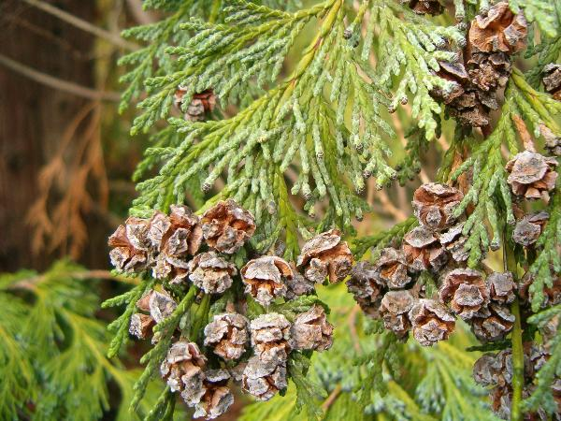
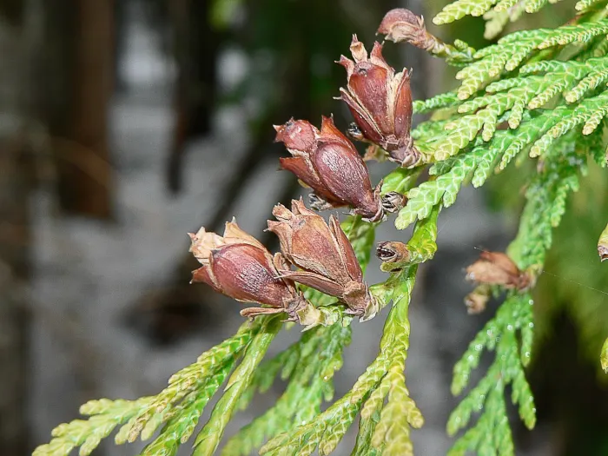
Abies amabilis
Pacific silver fir
Pseudotsuga menziesii
Douglas fir
Tsuga heterophylla
Western hemlock
Tsuga mertensiana
Mountain hemlock
Callitropsis nootkatensis
Yellow cedar
Thuja plicata
Western Redcedar
Source: Janneke Hille Ris Lambers
Source: iNaturalist
Notes:
We chose Mount Rainier for this study, and this simplified map shows the stands we selected, labeled across an elevational gradient on two sides of the mountain. Our collaborator, Janneke, has been collecting seed data in these stands for years. Individuals growing at higher elevations face more stressful environmental conditions, and we expect that their resource allocation strategies during masting years may differ from those at lower elevations. Furthermore, species may respond differently depending on their growth strategies—those with more conservative strategies might allocate resources differently from species with more acquisitive growth strategies. All these aspects at the same time will cause different populations respond differently towards climatic variations.
Species we selected for this study are listed in the table, they are common species and can be found in at least four stands. Pacific Silver Fir, Western Hemlock, Mountain Hemlock, Western Red Cedar and Yellow cedar are relatively conservative species. Douglas fir are relatively more acquisitive.

Slide 13
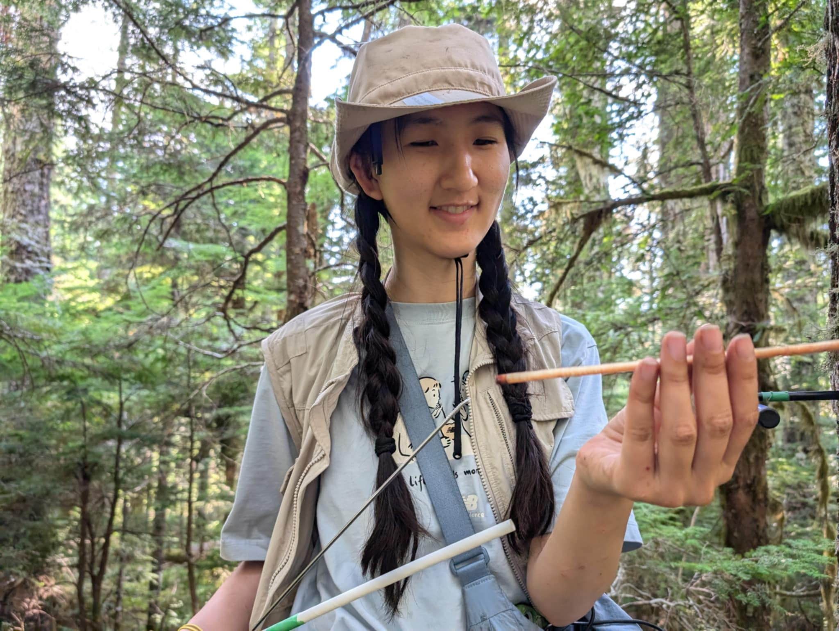
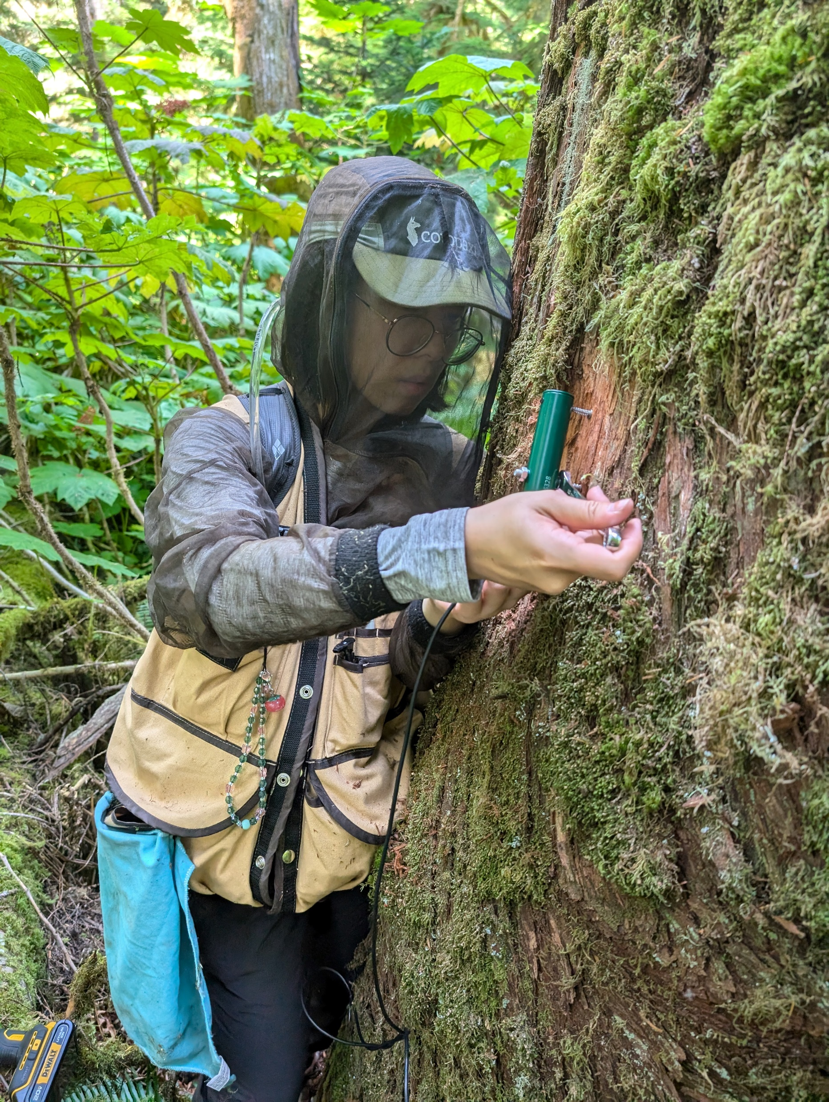
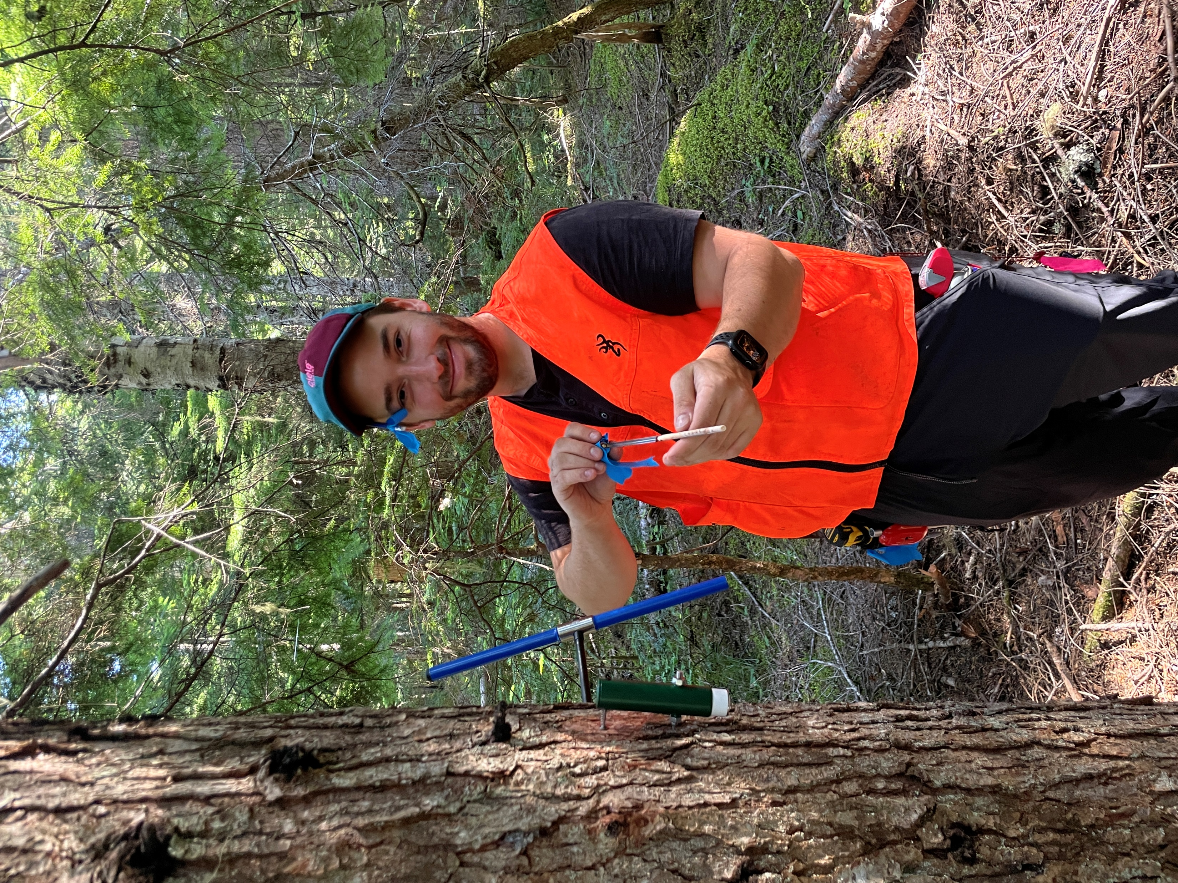

Samples collection
25 individuals per species per stand
DBH>25cm
Close to seed traps
Notes:
We planned to collect tree cores from 25 individuals per species per stand, covering a size gradient. To make sure that the trees we cored were mature enough to have reproduced at least 10 years ago, I selected only trees with a DBH greater than 25 cm. Additionally, I prioritized individuals located close to seed traps to better correlate with seed data. We expect to see a decrease in growth during the masting year, or even in the year before. However, we may also observe a period of increased growth leading up to the mast year. This relationship could vary between species and across different elevation gradients. Individuals at higher elevations may exhibit a more pronounced trade-off between growth and reproduction.

Slide 14
Changing climate and seed dynamics
Stand | Elevation
TA01 | ~700m
TO04 | ~700m
AO03 | ~900m
AG05 | ~950m
AV06 | ~1060m
AB08 | ~1100m
AM16 | ~1200m
AE10 | ~1450m
PARA | ~1600m
SUNR | ~1800m
Environmental factors on masting at Mt. Rainier
Elevation gradient as proxy of climate change
Long-term seed trap and climate data
Develop predictive models for seed dynamics in this area
Notes:
In this final chapter, I present an outline and would greatly appreciate any feedback or suggestions. The focus of this chapter is on how changing climate may affect seed dynamics, specifically the phenomenon of masting, in Mt. Rainier. Masting events are influenced by various environmental factors, including temperature and precipitation. To understand how climate change may influence future masting events, it is crucial to explore the relationship between these environmental factors and masting behavior. In this chapter, I aim to investigate the correlation between key environmental variables (e.g., temperature and precipitation) and masting events at Mt. Rainier. Our study sites span an elevation gradient, which offers a unique opportunity to explore the effects of climate change. Over the past decade, the climate at Mt. Rainier has already changed. Using long-term seed trap data and historical climate data, we can use the elevation gradient as a proxy for climate change. This will allow us to study how changes in climate are linked to masting events at Mt. Rainier. Ultimately, the goal is to develop predictive models that will help us understand how seed dynamics may evolve in this area in response to ongoing climate changes.

Slide 15

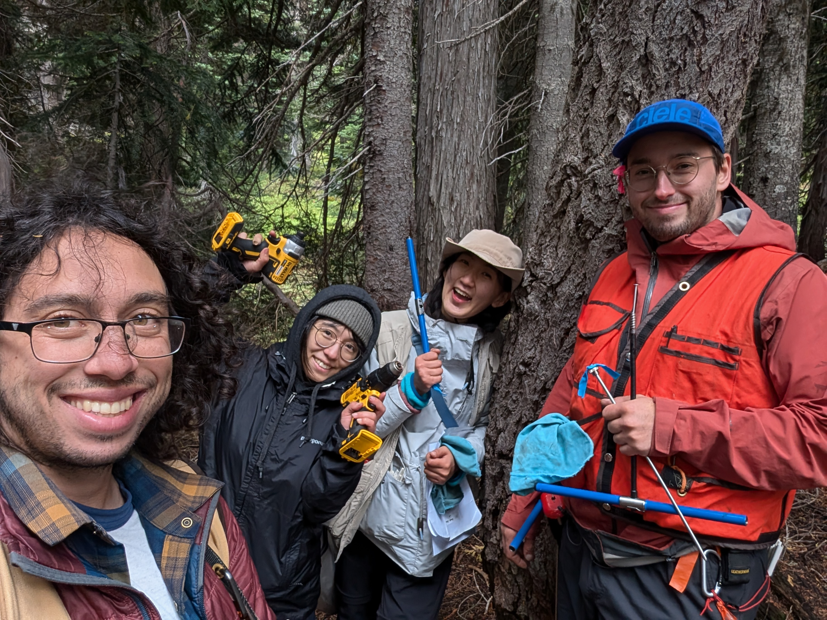
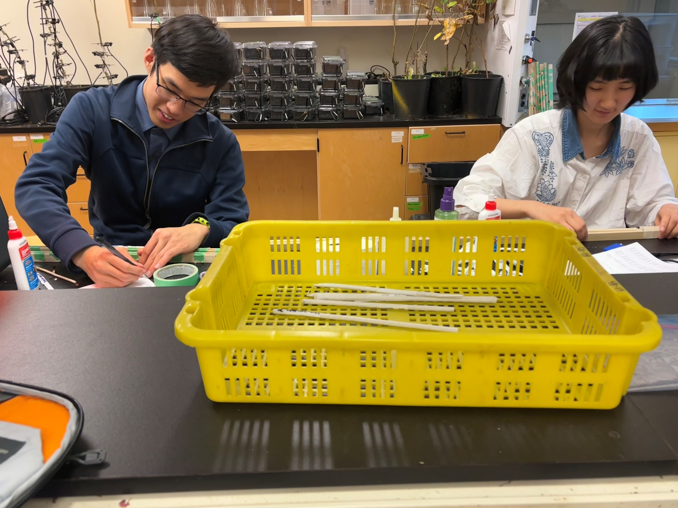
Current progress
Data scraping from Silvics almost done
Collected tree cores from more than 600 individuals
Mounting cores (3/10 stands done)
Notes:
During the past field season, I collected tree cores from more than 600 individuals in 10 stand at different elevations with the help of my awesome field crew.
We are currently mounting these tree cores, hopefully we will finish core mounting by the end of this year, and then we can start looking at our cores.
In the next year, I will concentrate on getting more data for my meta-analysis chapter and start analysis. I will finish scanning and checking all cores before next field season and see if collecting more cores are needed. If so, I will go to collect more cores in summer.

Slide 16
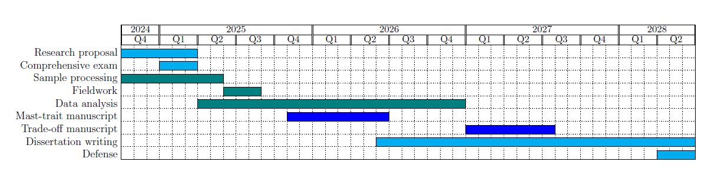
Timelines for milestones for PhD
Notes:
This is a drafted timeline for milestones for my PhD. The most recent two events are the submission of my proposal and comprehensive exam. I plan to finish my proposal by the end of February and send out for feedbacks. For the comprehensive exam, I plan to take it by the end of March, but I would love to discuss about this later and schedule a time together.

Slide 17



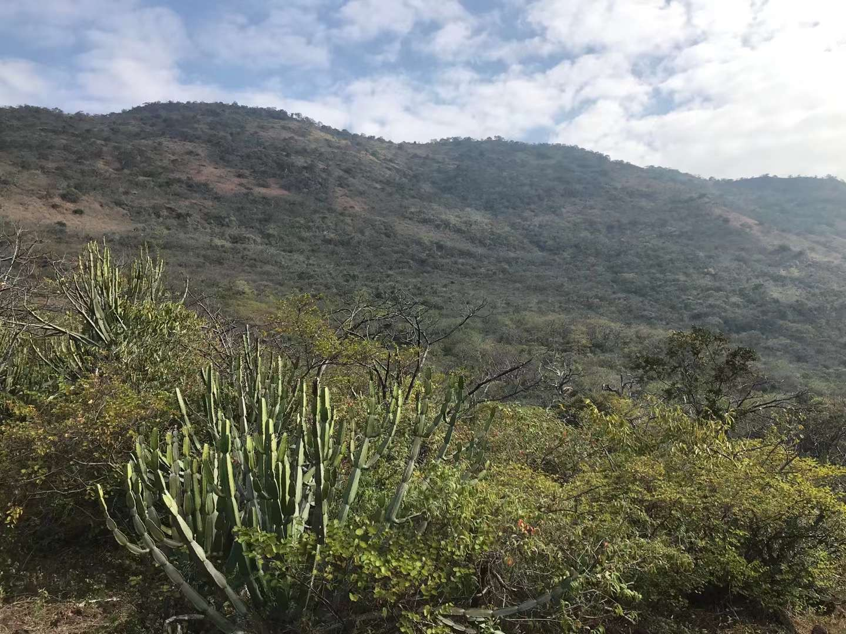
To be continue…
Notes:
Going back to where the story started, what’s on the other side of the mountain? Over the years, I’ve seen oceans, savannas, and all kinds of forests. And I thought I had reached the edge, but here we are—more mountains! This PhD journey is another opportunity to explore, learn, and push my boundaries, and I’m ready to take on whatever mountains come next.

Slide 18
Key references
Bogdziewicz, M., Pesendorfer, M., Crone, E.E., P´erez-Izquierdo, C. & Bonal, R. (2020) Flowering synchrony drives reproductive success in a wind-pollinated tree. Ecology Letters 23, 1820–1826.
Bogdziewicz, M., Szymkowiak, J., Kasprzyk, I., Grewling, L., Borowski, Z., Borycka, K., Kantorowicz, W., Myszkowska, D., Piotrowicz, K., Ziemianin, M. et al. (2017) Masting in wind-pollinated trees: system-specific roles of weather and pollination dynamics in driving seed production. Ecology 98, 2615–2625.
Hacket-Pain, A. & Bogdziewicz, M. (2021) Climate change and plant reproduction: trends and drivers of mast seeding change. Philosophical Transactions of the Royal Society B 376, 20200379.
Hacket-Pain, A., Foest, J.J., Pearse, I.S., LaMontagne, J.M., Koenig, W.D., Vacchiano, G., Bogdziewicz, M., Caignard, T., Celebias, P., Van Dormolen, J. et al. (2022) Mastree+: Timeseries of plant reproductive effort from six continents. Global Change Biology 28, 3066–3082.
Janzen, D.H. (1971) Seed predation by animals. Annual review of ecology and systematics pp. 465–492.
Kelly, D. (1994) The evolutionary ecology of mast seeding. Trends in ecology & evolution 9, 465–470.
Kelly, D. & Sork, V.L. (2002) Mast seeding in perennial plants: why, how, where? Annual review of ecology and systematics 33, 427–447.
Pearse, I.S., Koenig, W.D. & Kelly, D. (2016) Mechanisms of mast seeding: resources, weather, cues, and selection. New Phytologist 212, 546–562.

